Slide 1

Integration of I4.0 standards
Alina Arunova, Maxim Maltsev, Philipp Matyash, Sattar Rahimbeyli
Mentor: Irlán Grangel

Slide 2


Testing structure
Unit testing
Integration testing
System testing
Performance Testing
2
Notes:
2

Slide 3
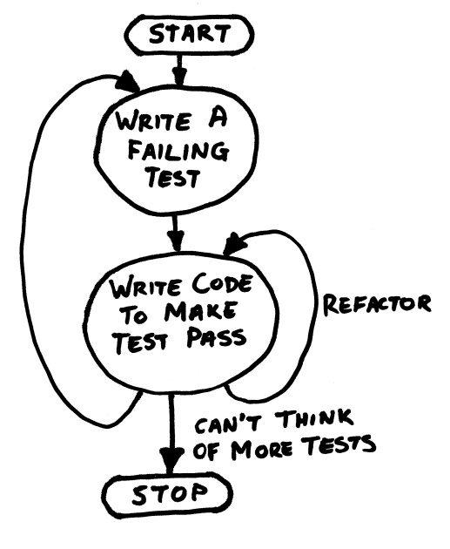



Unit testing
Unit testing verifies the functionality of a specific section of code.
Front End
Back End
3
Notes:
3

Slide 4


Integration/System testing
Integration and System testing will be held in order to find defects in the interfaces and interaction between modules.
Goals:
To test the communication between different layers of
the application using SoapUI;
To develop a tool for automatic testing;
To develop and use a Golden Standard as a measure of
the success.
4
Notes:
4

Slide 5
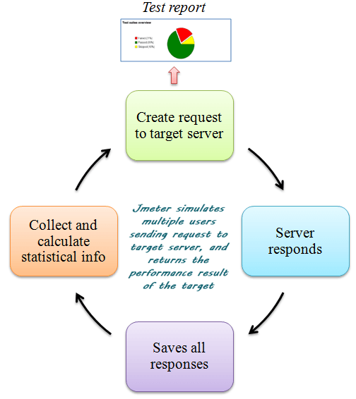



Performance testing
Performance testing should check
responsiveness and stability
under a particular workload.
5
Notes:
5

Slide 6
Integration of I4.0 standards
Q&A?
6

